Slide 1
CB scoring agreement between Josh and committee
Protein in NBs?
86% agreement
RNA in NBs?
71% agreement

Slide 2
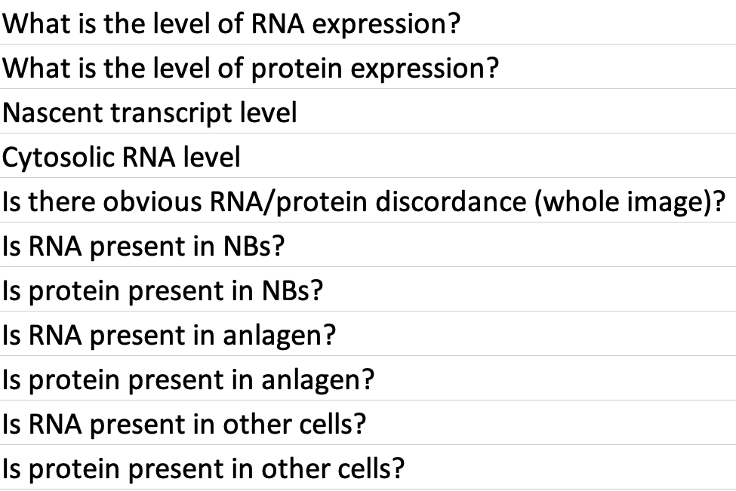
CB questions
Committee
Josh
RNA in CB (NB, progeny, or both)?
Protein in CB (NB, progeny, or both)?
Agreement = 77%

Slide 3
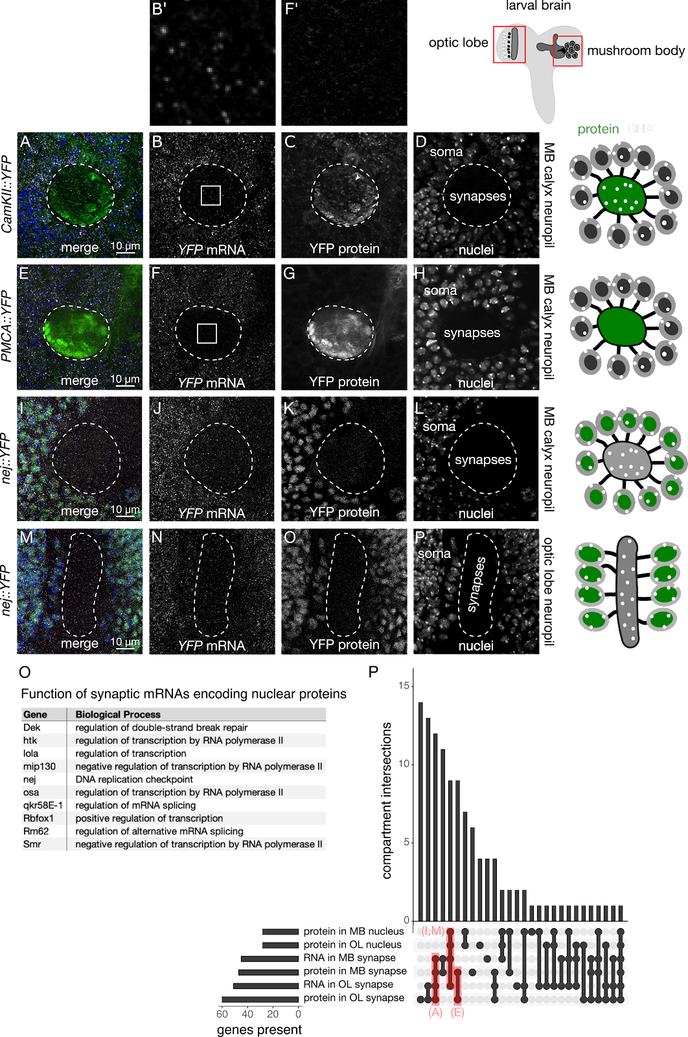
Figure 4

Slide 4
Figure 4
Nuclear expression not addressed by committee
Protein and RNA in MB neuropil have low agreement (44% and 54%)
Protein and RNA in OL neuropil have high agreement (76% and 80%)

Slide 5
NMJ scoring agreement between Josh and committee
Protein in NMJ axon terminal
89%
RNA in NMJ axon terminal
66%

Slide 6
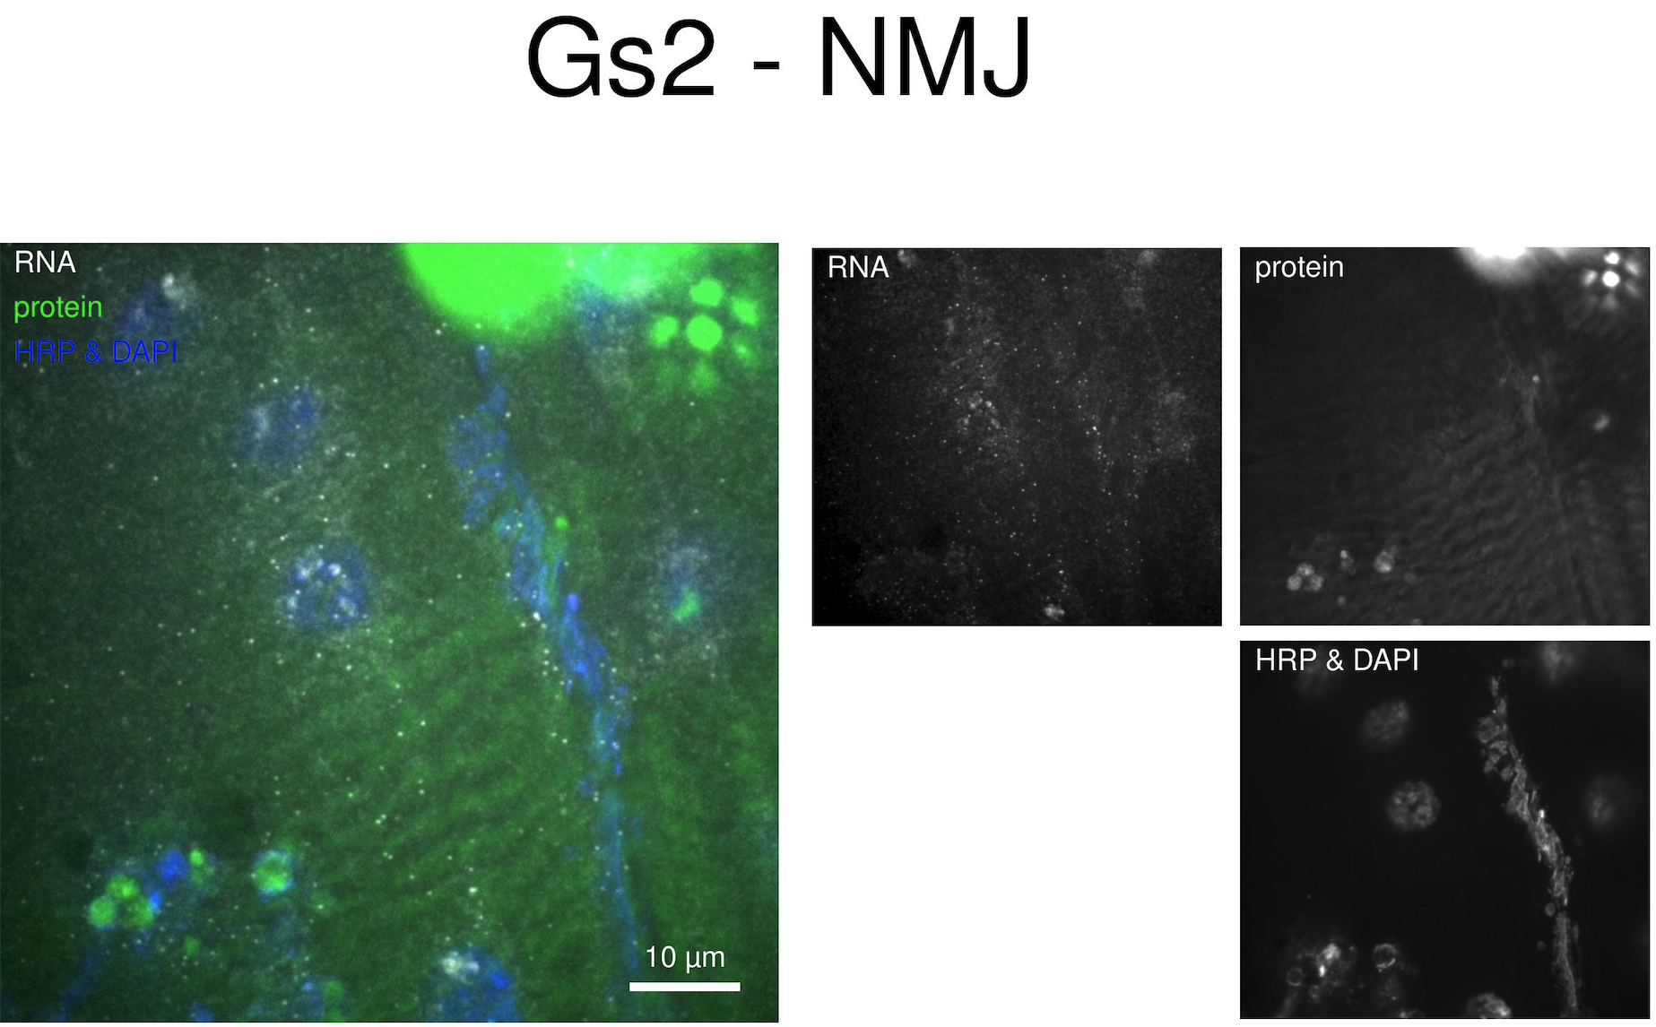
Josh = NO Committee = YES
Notes:
2138234

Slide 7
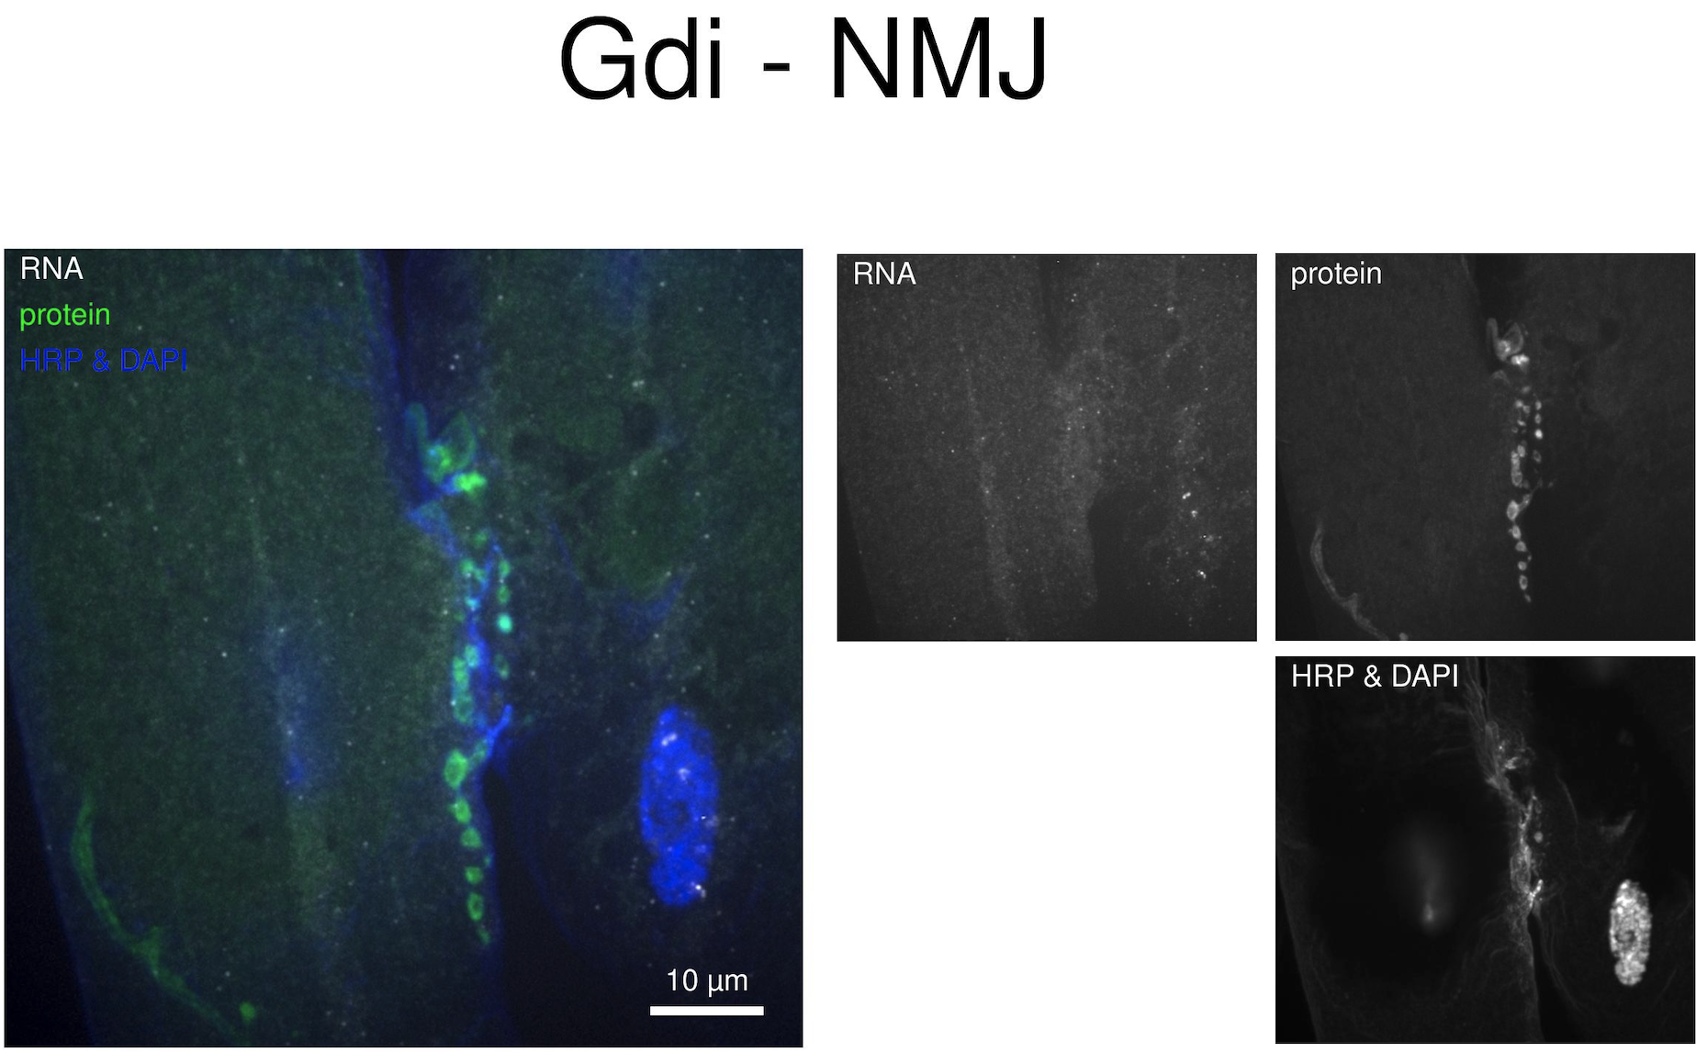
Josh = YES Committee = NO
Notes:
2138227

Slide 8
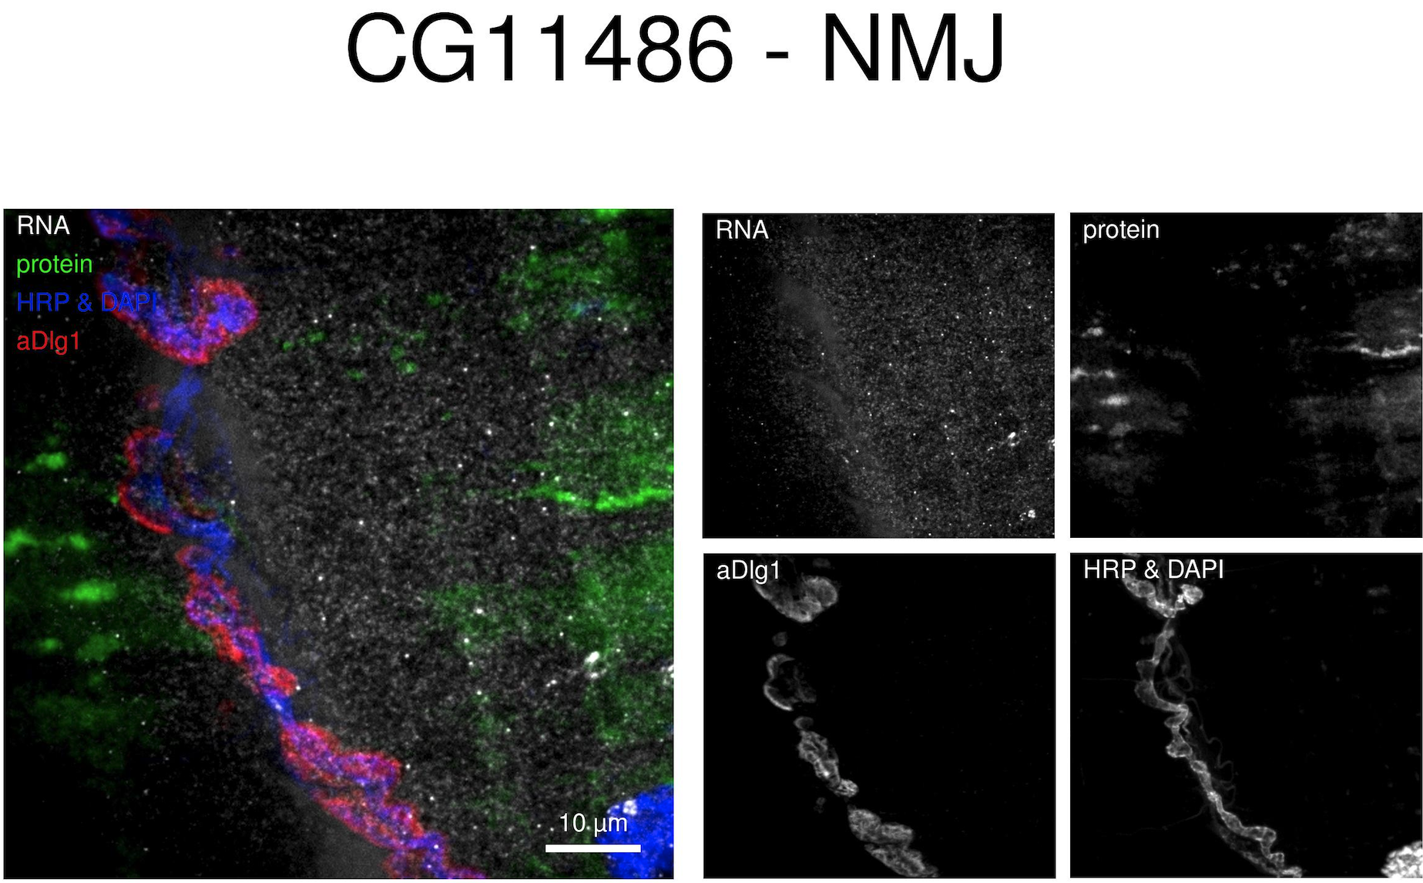
Josh = NO Committee = YES
Notes:
2138205

Slide 9
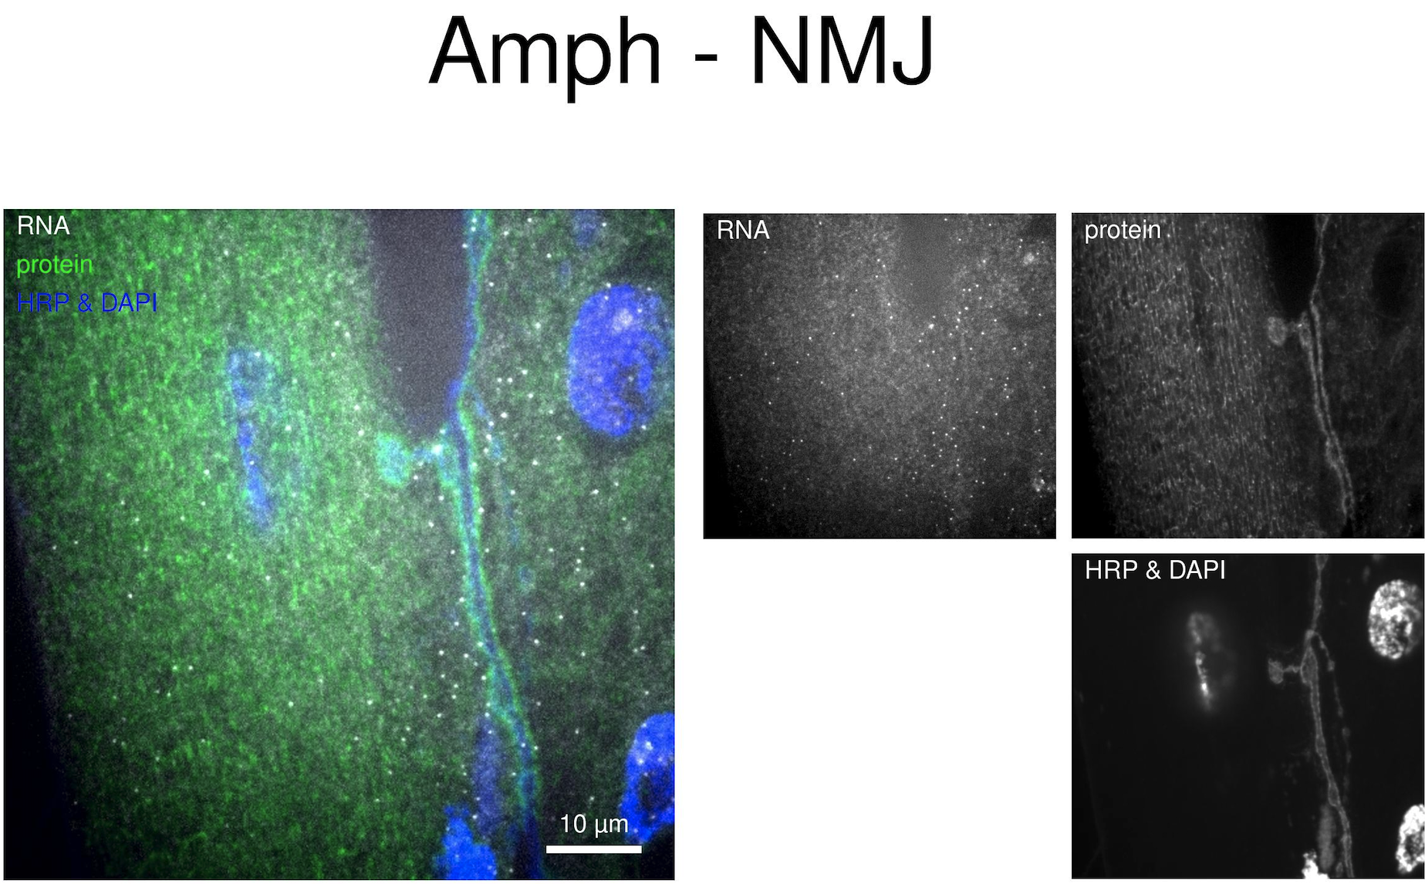
Josh = YES Committee = NO
Notes:
2138175

Slide 10
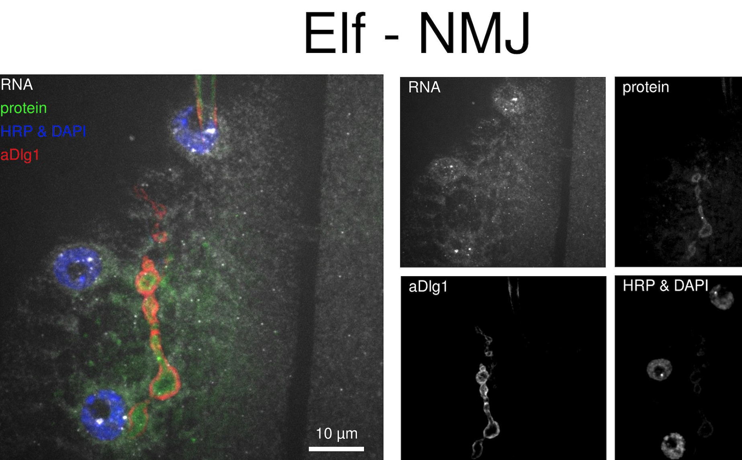
Josh = YES Committee = NO
Notes:
2138113

Slide 11
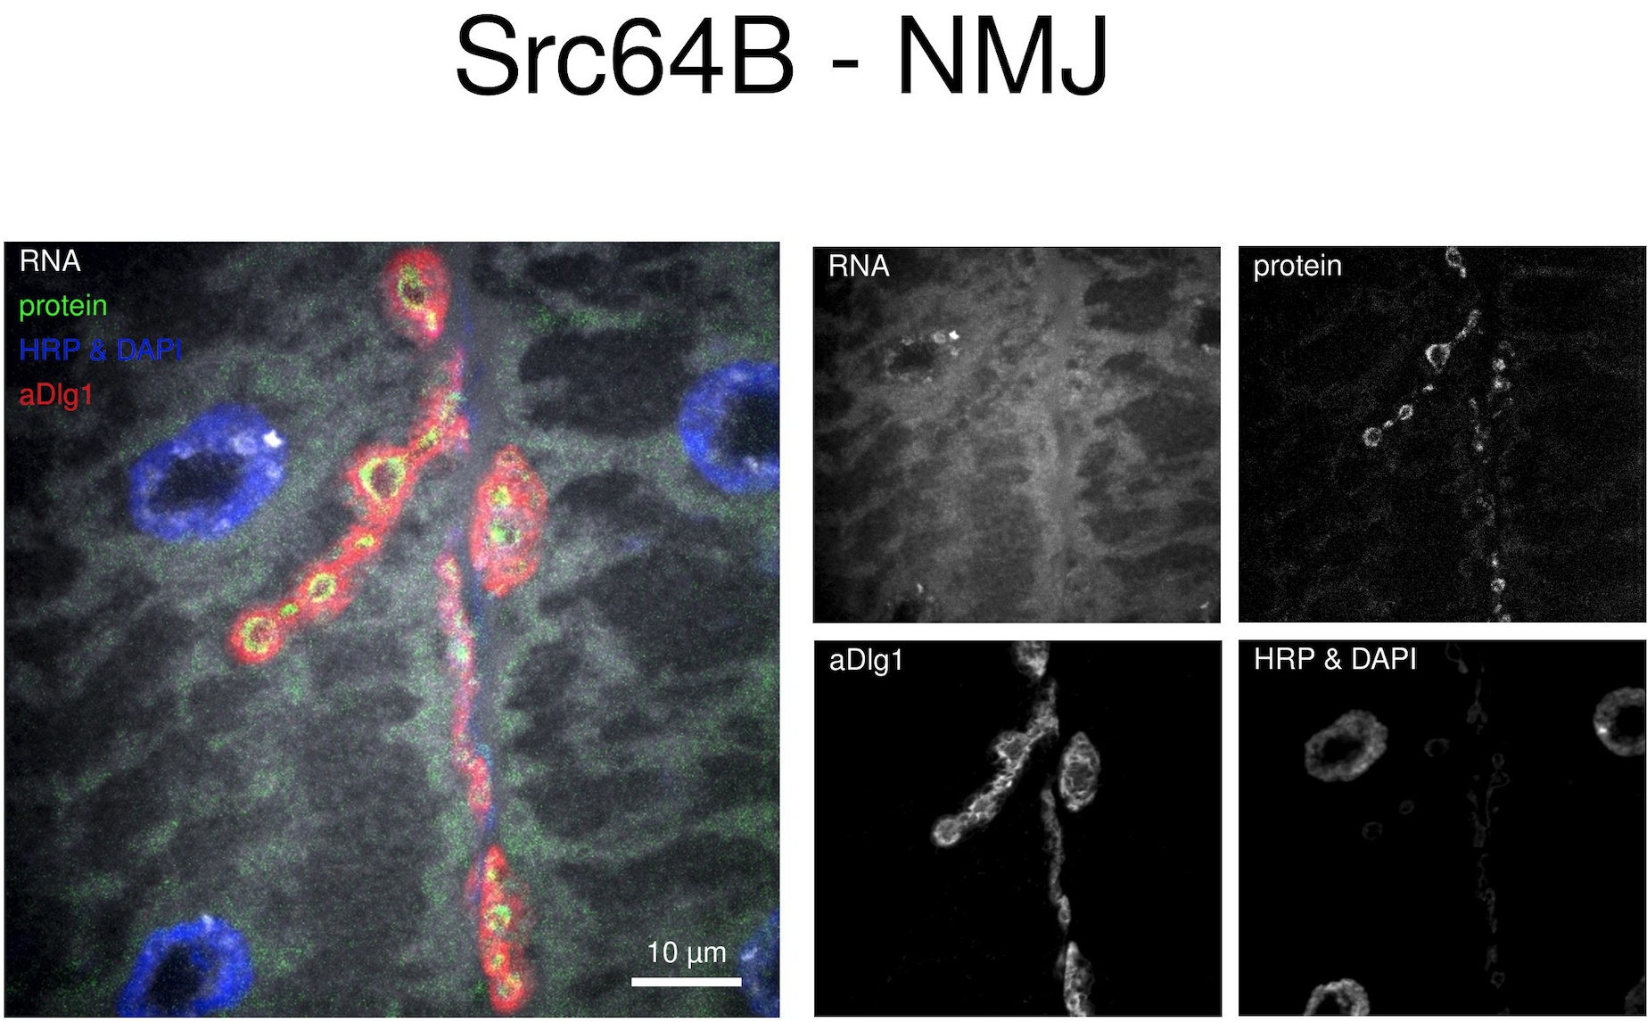
Josh = YES Committee = NO
Notes:
2138111

Slide 12
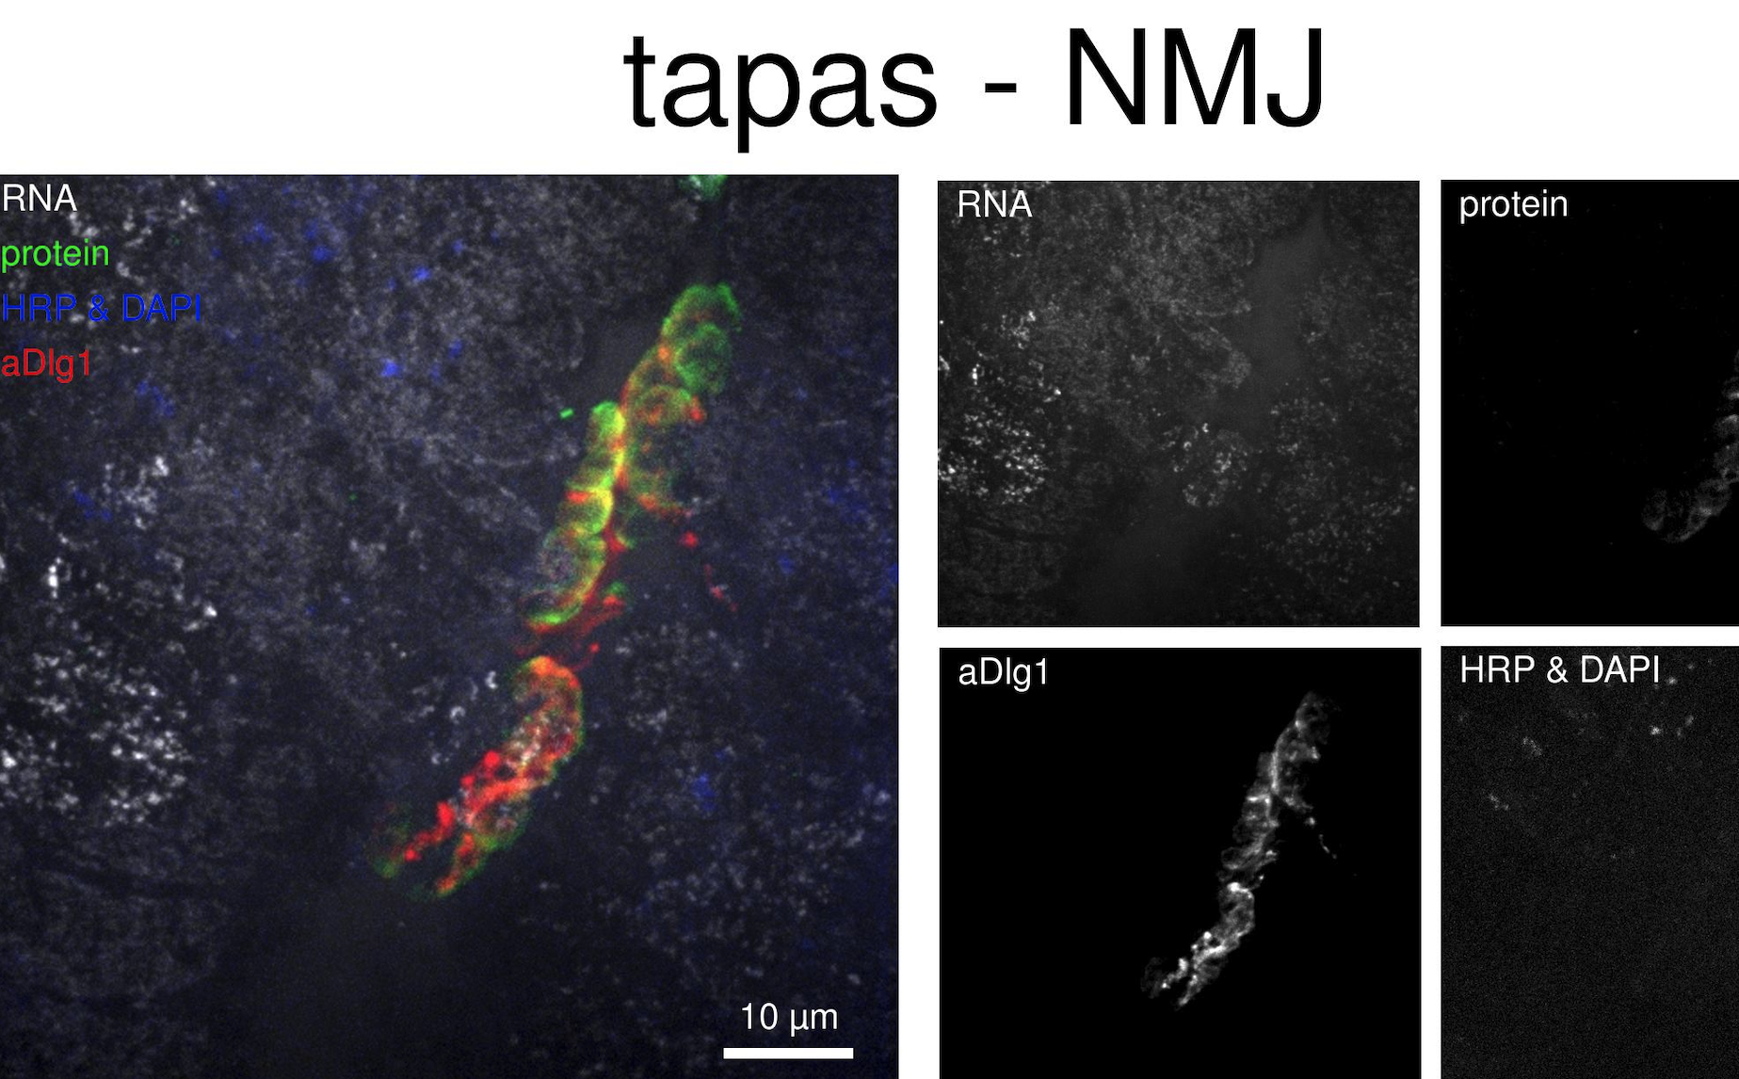
Josh = NO Committee = YES
Notes:
2138098

Slide 13
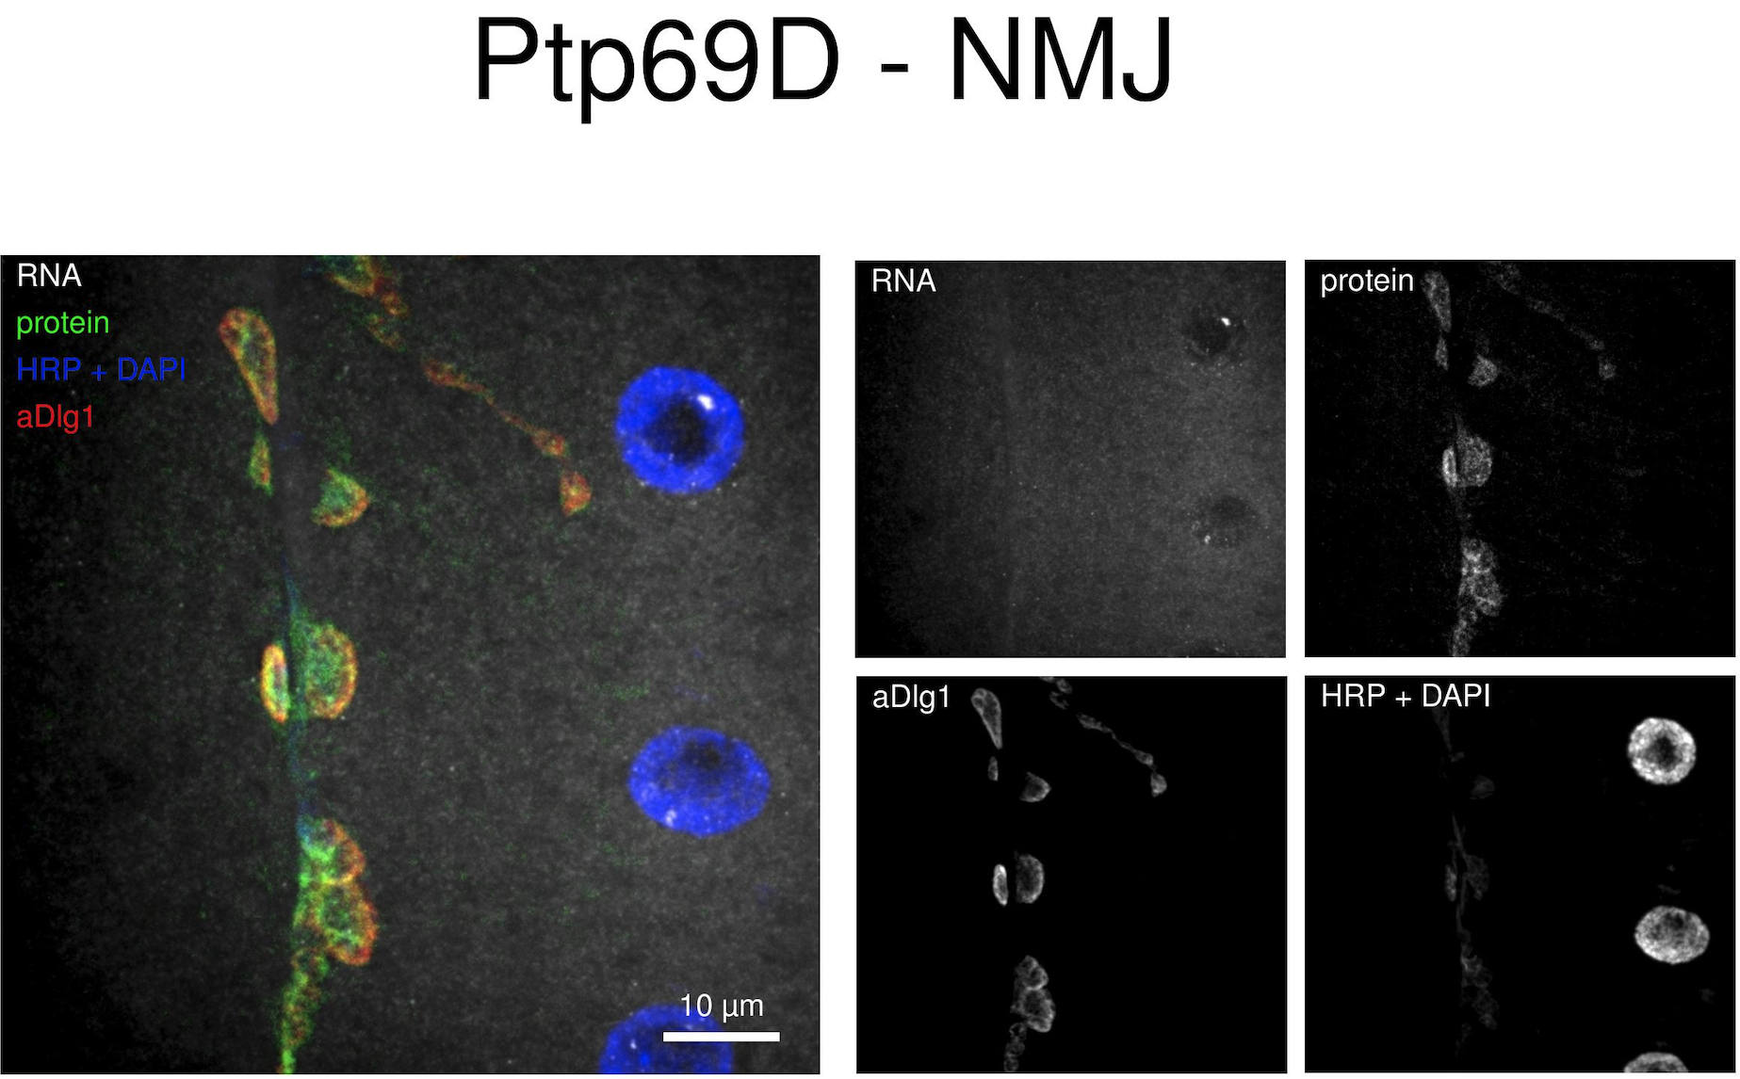
Josh = YES Committee = NO
Notes:
2138228

Slide 14
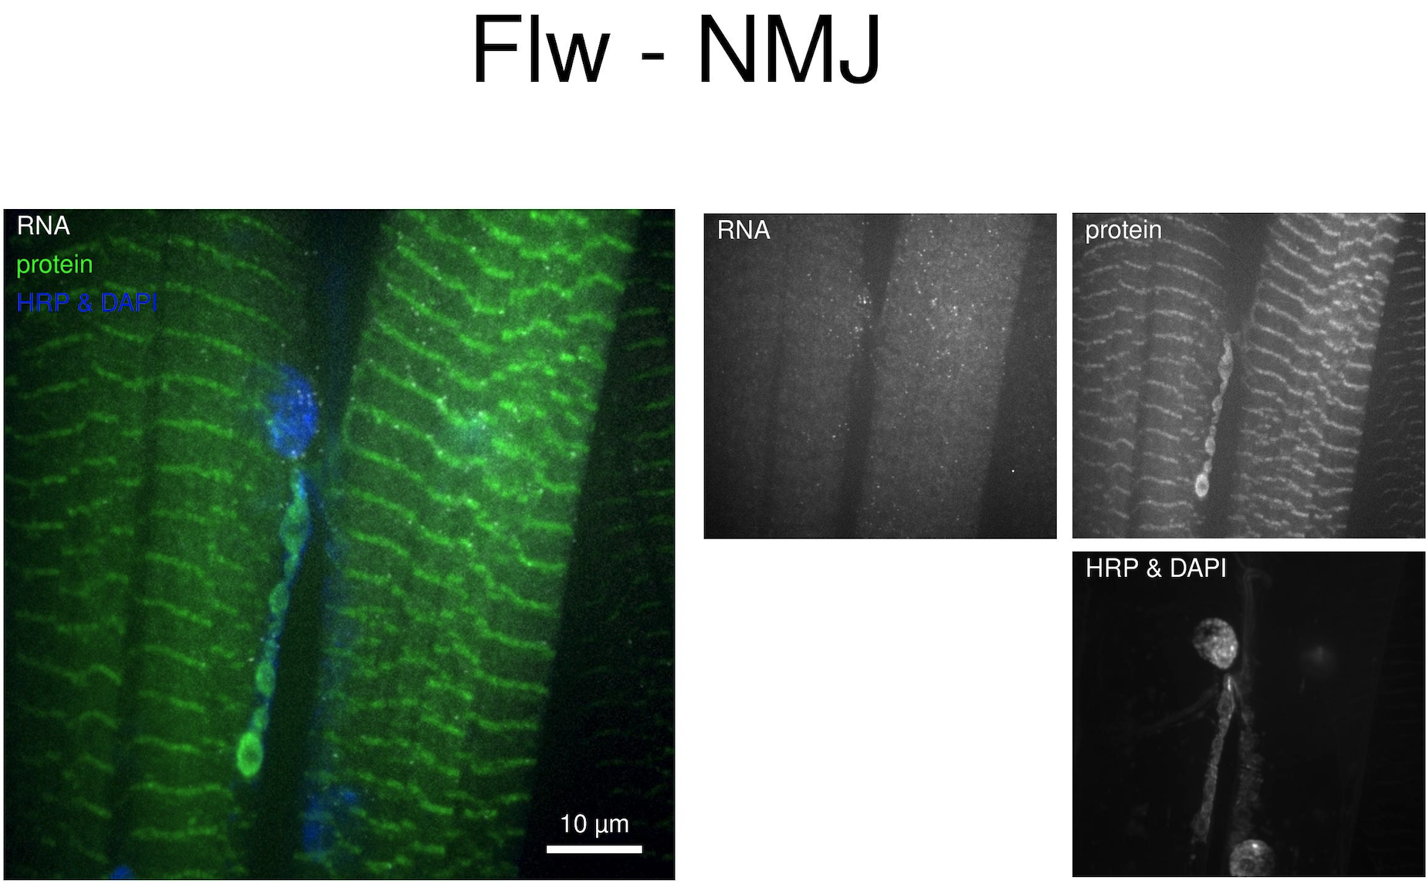
Josh = YES Committee = NO
Notes:
2138225

Slide 15
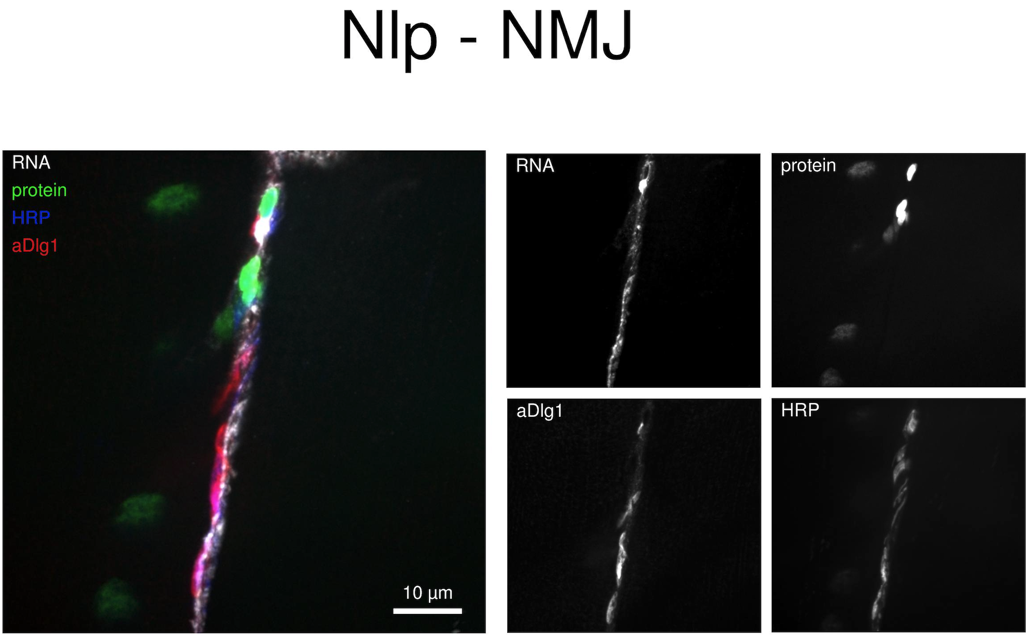
Josh = NO Committee = YES
Notes:
2138231

Slide 16
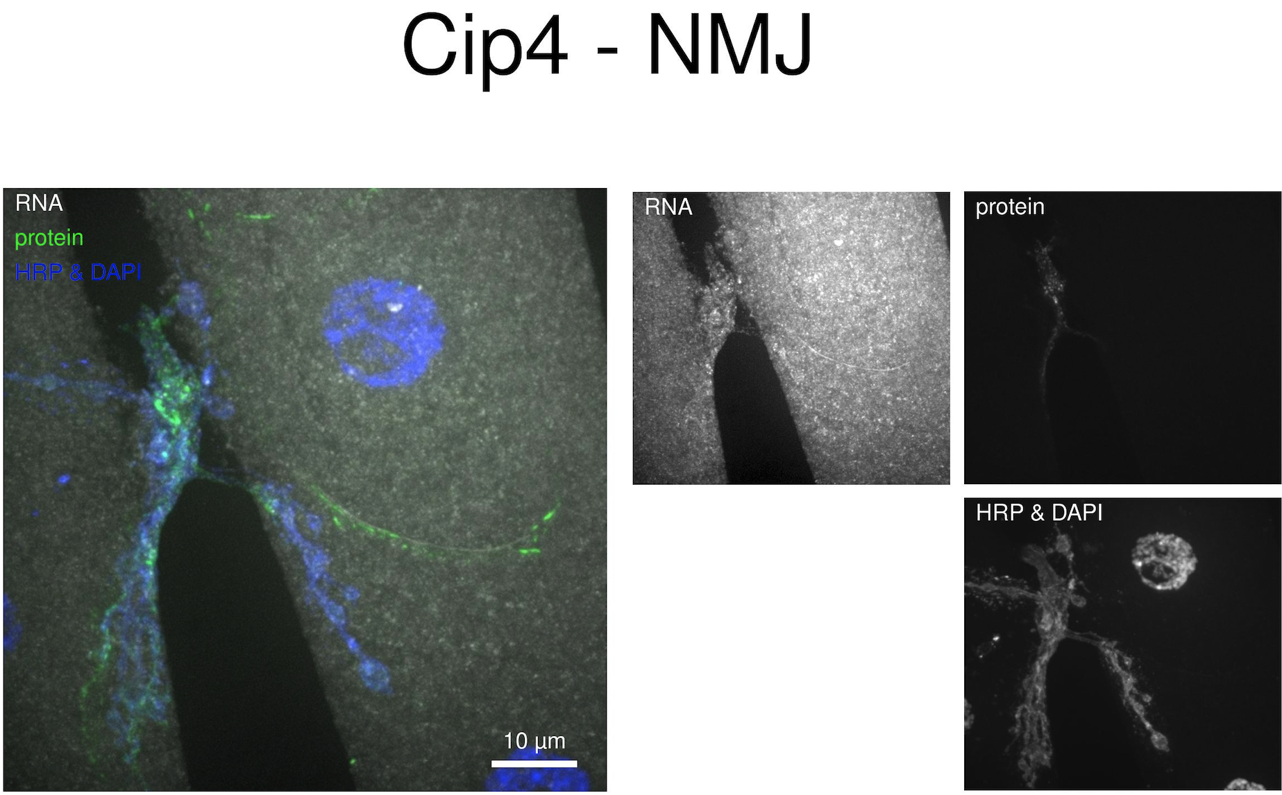

Slide 17
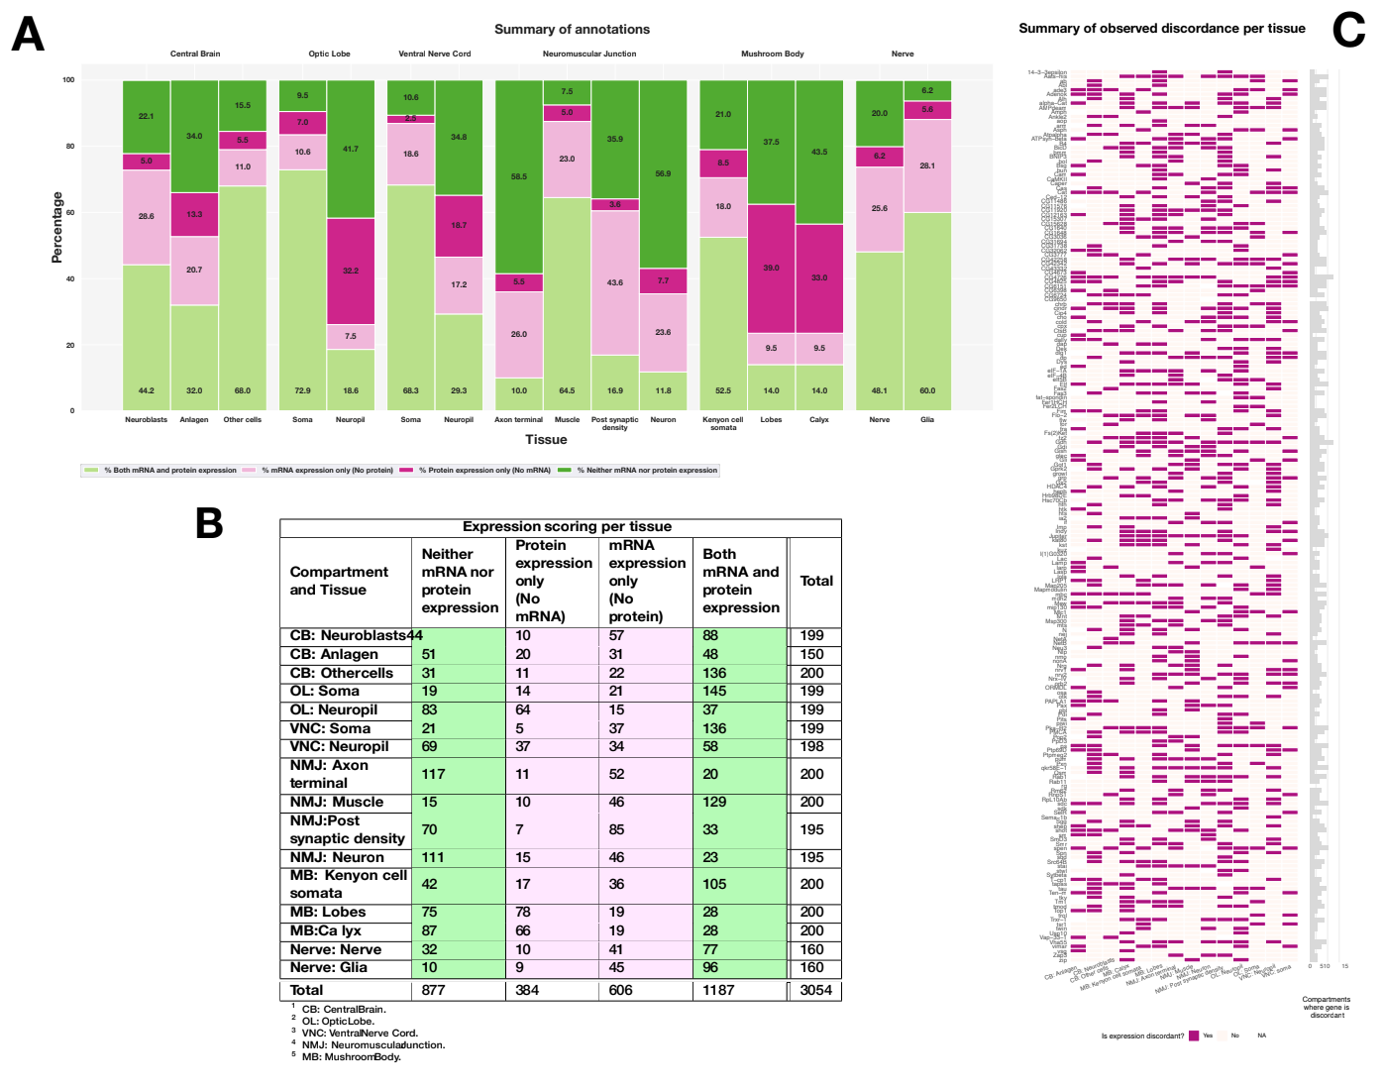
X
We do need to address the 1-2 genes that aren’t scored
Just add text to panel A that says out of 200 genes
A summary table or plot would be useful to help explain panel C

Slide 18
X

Slide 19
I like having the genes in order, but think it would be more useful to sort them by # of compartments with discordance

Slide 20
ACTIONS
Reconcile MB, CB, OL, NMJ data
Convert CB and OL to committee
Have a meeting to reassess NMJ and MB
Adjust language
Complete CNS nuclei data (~10 images)
Update Upset plot
Rewrite Results to be more clear
Determine total number of genes that show discordance
Fix Figure 3
Write Caveat statement on annotation uncertainty in the Discussion
Write in the the Summary Scoring Figure
Revise Methods description of scoring
Add Supplemental Figure of Zegami instance (Maria)
Final check of all reference to percentages
Send Maria script for generating metadata
Fix sgg/overview mapping issue (check that latest .tsv file is ok)
Fix Fbgn mapping using ScreenPaperWriting > MASTERsmFISHscreenDatabase data
Update Upset plot in Figure 5
Add RnpS1 figure or remove reference

Slide 21
DISCUSS WITH MARIA
Grabbing data from

